Slide 1
Fair use notice
The material used in this presentation i.e., pictures/graphs/text, etc. is solely intended for educational/teaching purpose, offered free of cost to the students for use under special circumstances of Online Education due to COVID-19 Lockdown situation and may include copyrighted material - the use of which may not have been specifically authorized by Copyright Owners. It’s application constitutes Fair Use of any such copyrighted material as provided in globally accepted law of many countries. The contents of presentations are intended only for the attendees of the class being conducted by the presenter.

Slide 2
OBJECT ORIENTED PROGRAMMING
Presented by: Engr. Mariam Memon

Slide 3

Table of contents
Installation of Java
Lexical Structure
Identifiers
Literals
Variables & Data Types
Type Casting & Conversion
Automatic Type Promotion

Slide 4
Installation of java
You will see two folders; JDK and JRE
JDK – contains programs needed to develop java programs
It contains : java compiler-javac.exe and java application launcher- java.exe and many other tools.
JRE; is run time environment contains JVM and Java library.
JVM is platform independent-
JVM is a virtual machine provides means of platform independent – interprets java byte code into machine code based on operating system and underlying hardware

Slide 5
Lexical structure
Java programs are a collection of whitespace, identifiers, comments, literals, operators, separators, and keywords.
Whitespace: Java is a free-form language- no especial indentation rules.
In Java, whitespace is a space, tab, or newline.

Slide 6
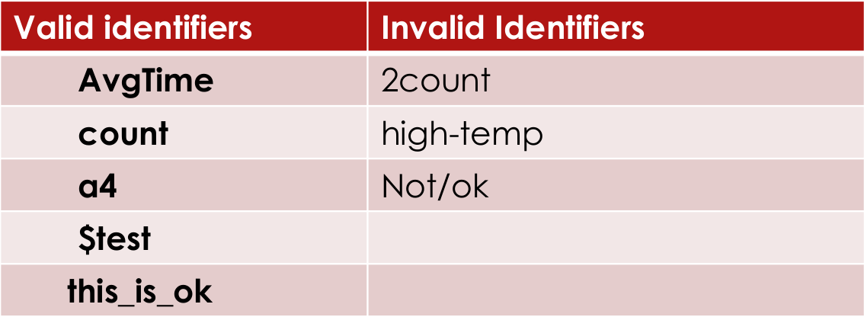
identifiers
Identifiers: An identifier may be any descriptive sequence of uppercase and lowercase letters, numbers, or the underscore and dollar-sign characters. They must not begin with a number.
Again, Java is case-sensitive, so VALUE is a different identifier than Value.

Slide 7
Literals
A constant value in Java is created by using a literal representation of it. For example,
here are some literals:
100 98.6 ‘X’ “This is a test”

Slide 8
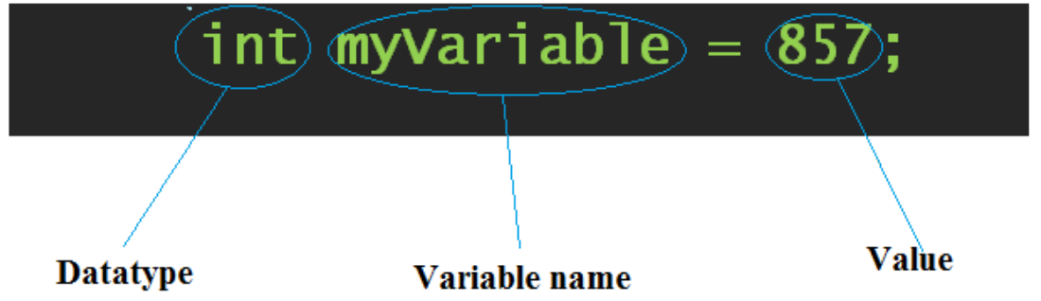
Variables and Data types
A variable is a program component used to store or represent data.
The number, letter, or other data item in a variable is called its value.
The value for a variable can be changed in the program.
Each variable that you declare can store values only of a type consistent with the data type of that variable.
Example:

Slide 9
Data types
The only things in Java that are not objects are data types.
The fundamental types are referred to as primitive types.
The values can fall in one of the following category:
1. Numeric values, which can be either integer or floating-point
2. single Unicode character
3. Logical values that can be true or false

Slide 10
Contd.
Java is strictly typed language
Every variable has a type, every expression has a type, and every type is strictly defined.
Second, all assignments, whether explicit or via parameter passing in method calls, are checked for type compatibility.
There are no automatic conversions of conflicting types as in some languages.
The Java compiler checks all expressions and parameters to ensure that the types are compatible.
Any type mismatches are errors that must be corrected before the compiler will finish compiling the class.

Slide 11
Data types
The only things in Java that are not objects are data types.
The fundamental types are referred to as primitive types.
Java defines eight simple (or elemental) types of data: byte, short, int, long, char, float, double, and boolean.
Integers: This group includes byte, short, int, and long, which are for whole valued.
Floating-point numbers: This group includes float and double, which represent numbers with fractional precision.
Characters: This group includes char, which represents symbols in a character set, like letters and numbers.
Boolean: This group includes boolean, which is a special type for representing true/false values.

Slide 12
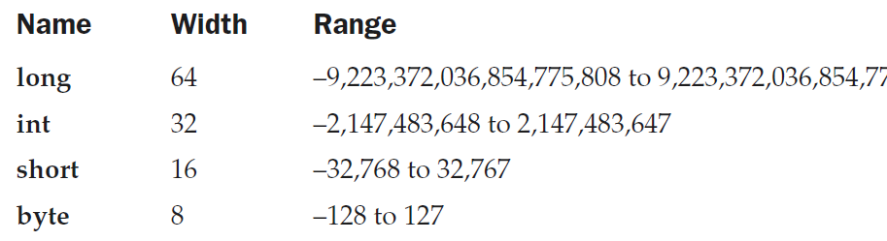
integers
Java defines four integer types: byte, short, int, and long.
All of these are signed, positive and negative values.

Slide 13
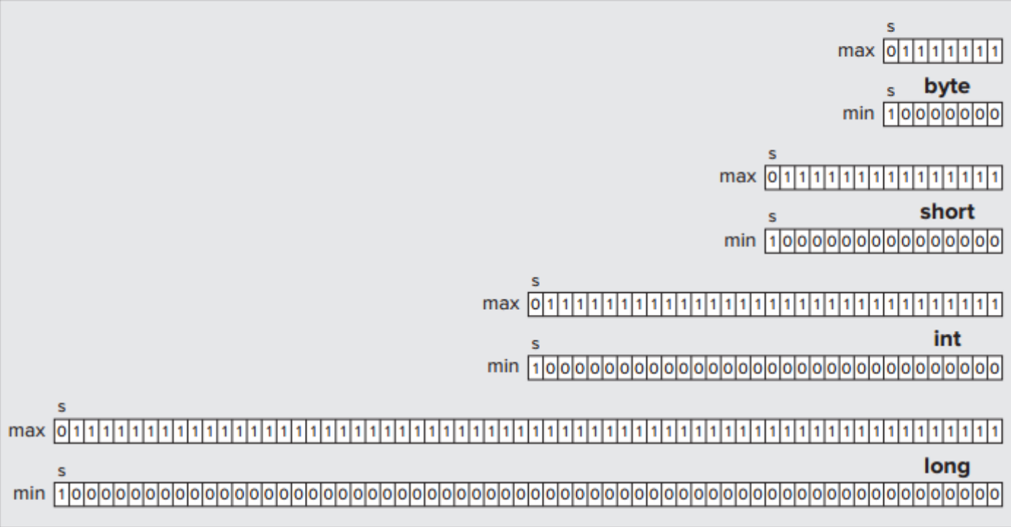
integers
The diagram below shows the number of bits available to store each type that determines the maximum and minimum values.
Negative binary numbers are represented in what is called 2's complement form

Slide 14
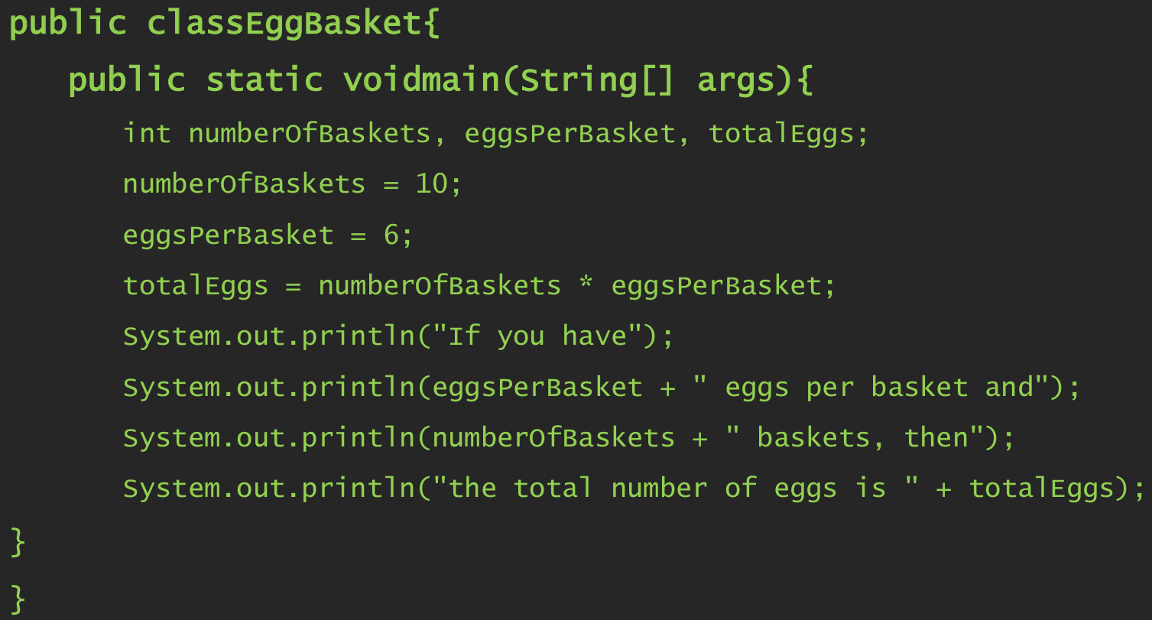
example

Slide 15
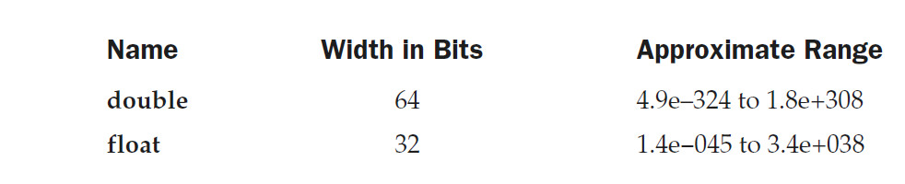
Floating points
Used when evaluating expressions that require fractional precision.
For example, calculations such as square root, or transcendentals such as sine and cosine, result in a value whose precision requires a floating-point type.

Slide 16
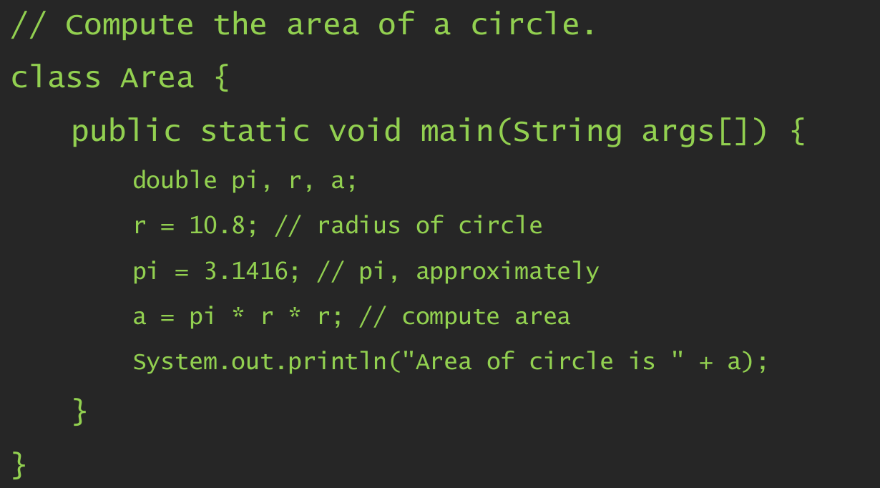
example

Slide 17
characters
Data type used to store characters is char.
char in Java is not the same as char in C or C++.
In C/C++, char is an integer type that is 8 bits wide.
Java uses Unicode to represent characters- 16 bits.

Slide 18
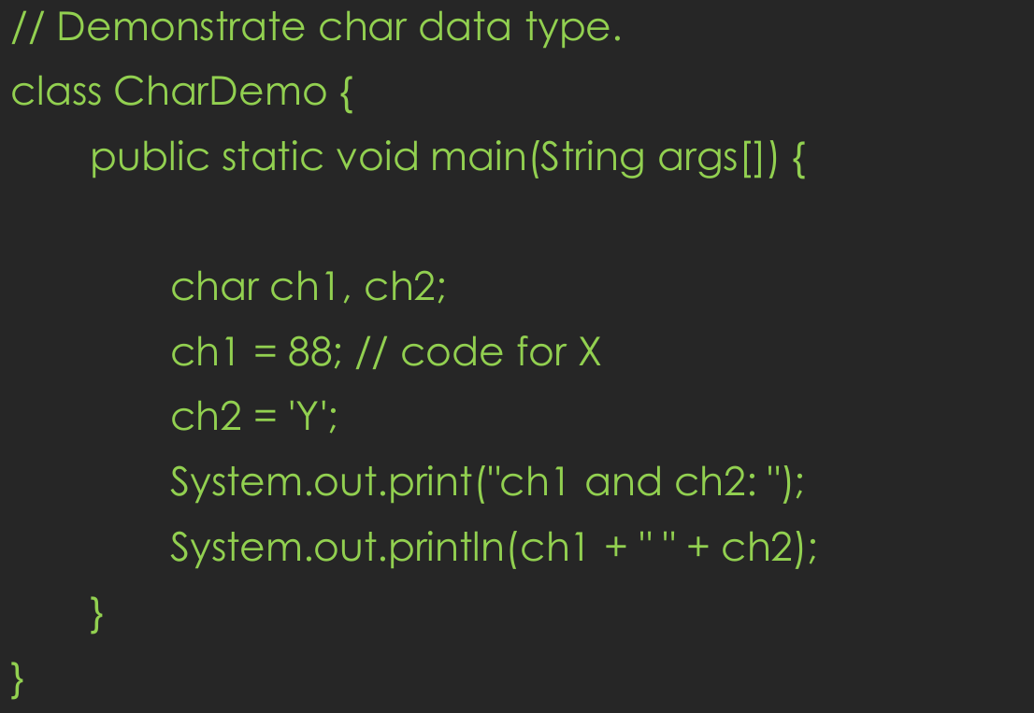
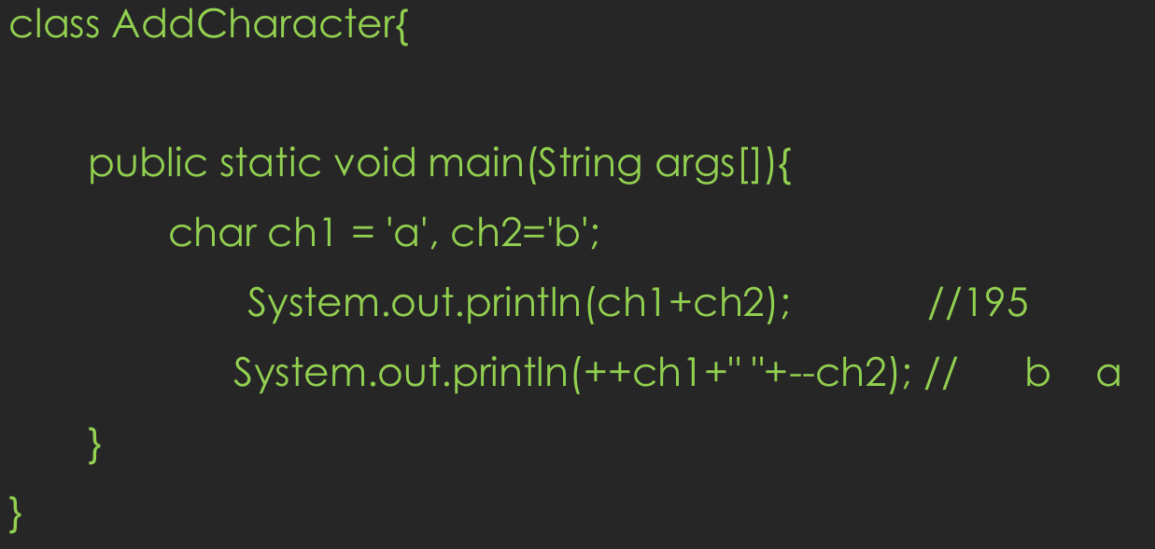
example

Slide 19
booleans
Java has a simple type, called boolean, for logical values.
It can have only one of two possible values, true or false.
This is the type returned by all relational operators, such as a < b.

Slide 20
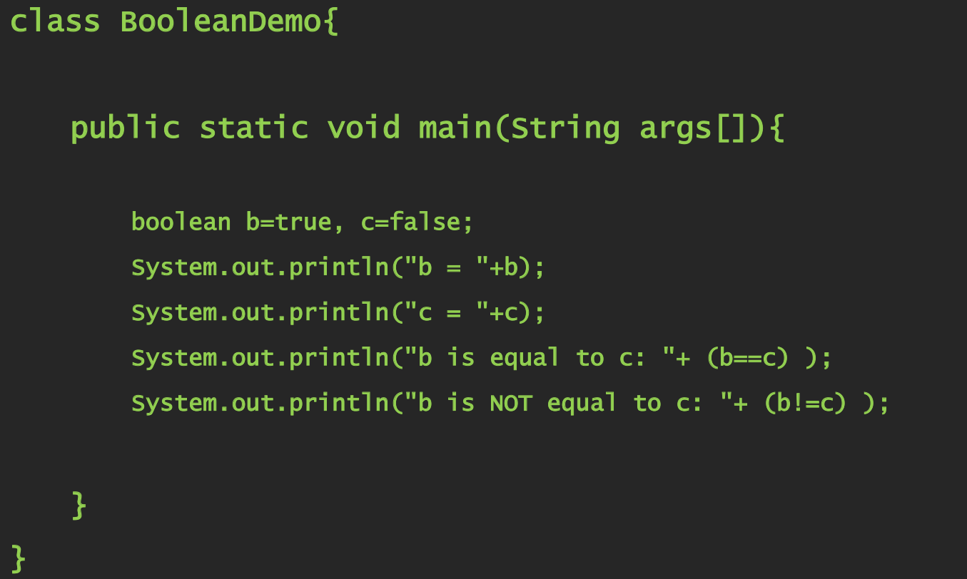
example

Slide 21
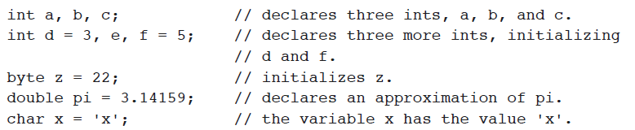
Variable declaration & initialization
In Java, all variables must be declared before they can be used. The basic form of a variable declaration is shown here:
type identifier [ = value][, identifier [= value] ...] ;
To declare more than one variable of the specified type, use a comma-separated list.

Slide 22
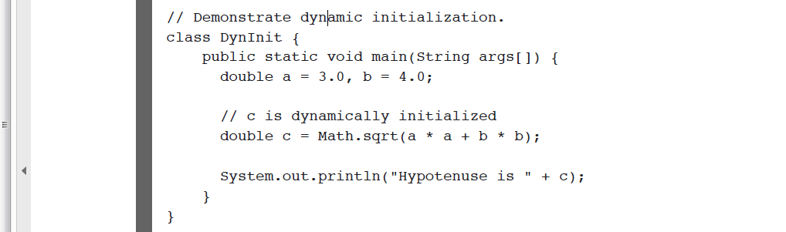
Dynamic initialization
Although the preceding examples have used only constants as initializers, Java allows variables to be initialized dynamically, using any expression valid at the time the variable is declared.

Slide 23
Type casting & conversion
Assigning a value of one type to a variable of another type is known as Type Casting.
Example
int x = 10;
byte y = (byte) x;
In Java, type casting is classified into two types:
Widening Conversion or Implicit Type Casting
Narrowing Conversion or Explicit Type Casting

Slide 24
Widening conversion
When one type of data is assigned to another type of variable, an automatic type conversion will take place if the following two conditions are met:
The two types are compatible.
The destination type is larger than the source type.
Widening Conversion: it takes place when two types are compatible
e.g. byte value assigned to int type.
There are no automatic conversions from the numeric types to char or boolean.

Slide 25
Narrowing conversion
A cast is simply an explicit type conversion.
Narrowing conversion takes place when a value of larger data type is assigned to the variable of smaller data type.
Example: An int value to a byte variable.

Slide 26
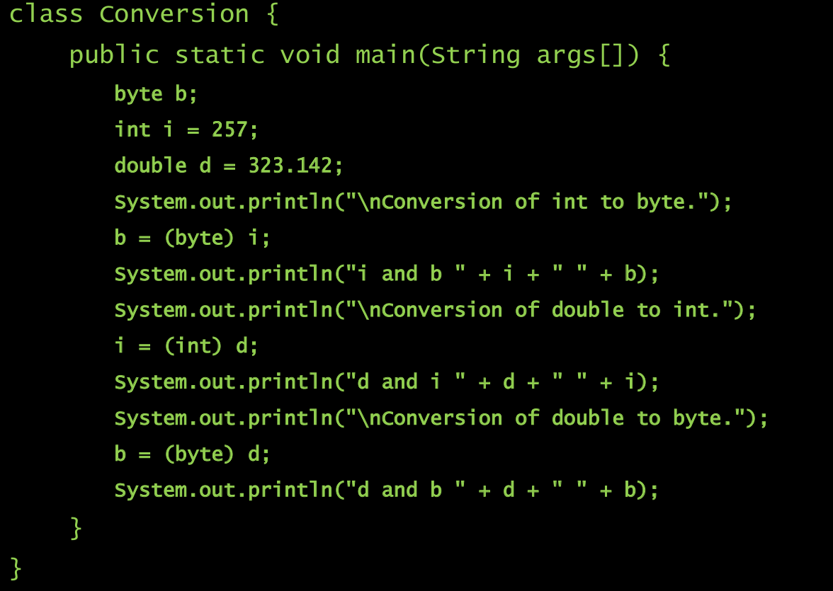
example

Slide 27
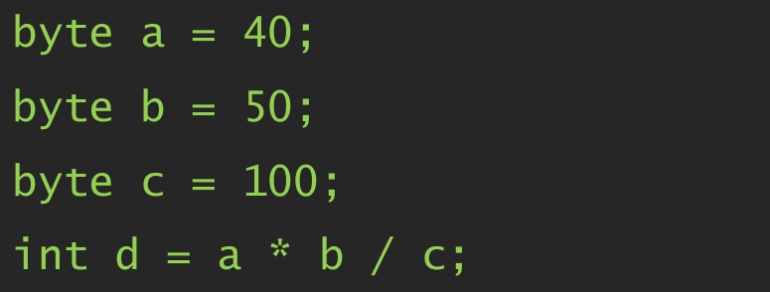
Automatic type promotion
Why Automatic type promotion takes place?
Consider the following example.

Slide 28
Automatic type promotion rules
All byte, short, and char values are promoted to int.
Then, if one operand is a long, the whole expression is promoted to long.
If one operand is a float, the entire expression is promoted to float.
If any of the operands is double, the result is double.

Slide 29
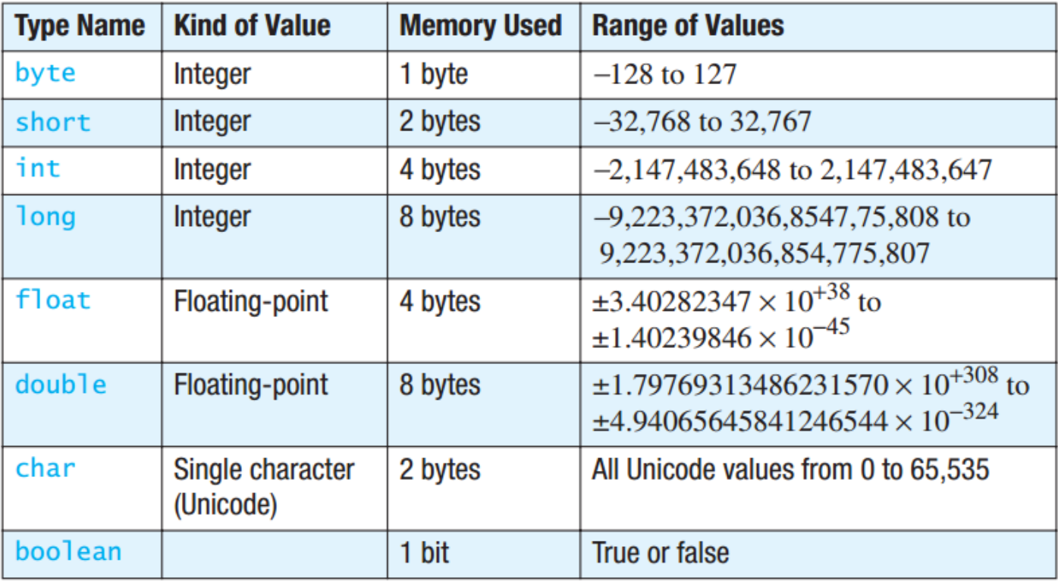
Summary

Slide 30
THANK YOU!

